Slide 1



Children home unattended polysomnography: feasibility, quality and patients and caregivers' satisfaction
Maria-Antonia QUERA SALVA, MD-PhD
UPNOS, Garches, France
AdSalutem, Barcelona, Spain
Rebecca SAUVAGNAC MD Sleep Med and Child Physiatrist
Robert CILVETI MD Sleep Med and Pediatrician
Rina RAVIV Neuropsychologist
Anna MILLET Psychologist
Ana NARCISO Sleep Technologist

Slide 2
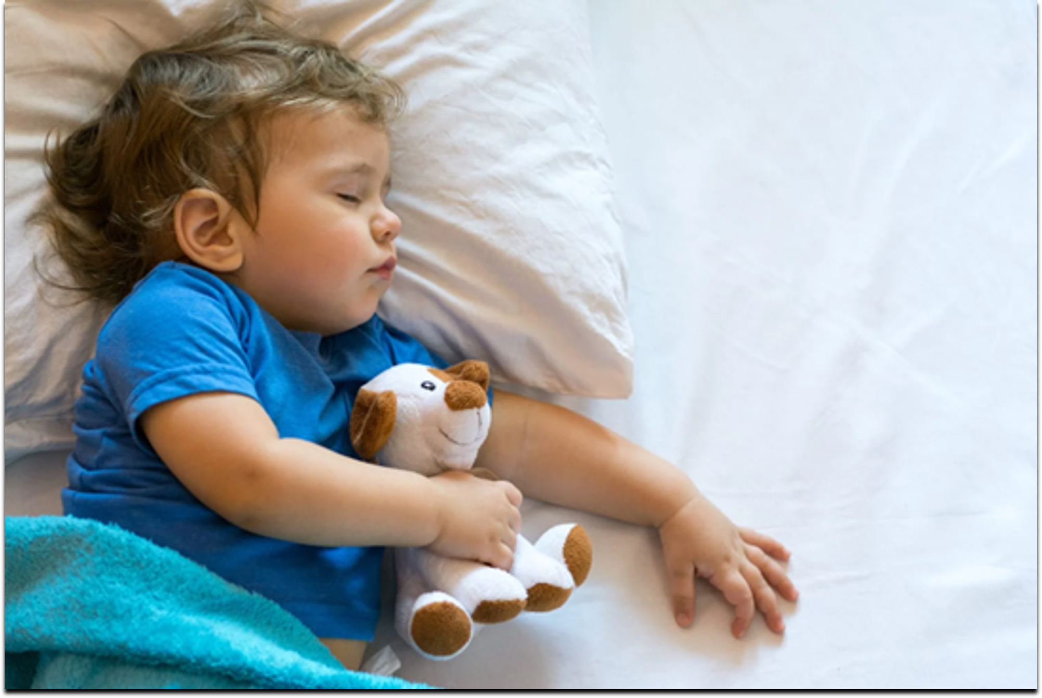
Sleep disorders in children are frequent
Sleep apnea , restless legs and/or periodic leg movements are frequent in children
May interfere with their family life and academic performances with attention difficulties, hyperactivity, irritability, and weight gain .
Snore | 27% ^{1,2}
Obstructive sleep apnea | 1 – 5% ^{1, 2}
Restless legs syndrome Sensation of stretching legs in the evening and/or kicking during sleep | 1 – 4% ^{3,4}
American Academy of Sleep Medicine. International Classification of Sleep Disorders: Diagnostic and Coding Manual. 2nd ed. Westchester, Ill.: American Academy of Sleep Medicine; 2005.
Marcus CLet al.; American Academy of Pediatrics. Diagnosis and management of childhood obstructive sleep apnea syndrome. Pediatrics 2012.
Aurora RN et al.; American Academy of Sleep Medicine. Practice parameters for the respiratory indications for polysomnography in children. Sleep. 2011
KA Carter Common Sleep disorders in children Am Fam Physician. 2014.
Notes:
Sleep Disorders in Children
Recent
research has led scientists to hypothesize that Stage 3 (deep non-Rapid Eye Movement sleep, or Slow Wave Sleep) may be especially important for the improvement of
memory retention and recall MRI scans indicate that the slow brain waves of stage 3 sleep (deep NREM sleep) “serve as a courier service,” transporting memories from the hippocampus to
other more permanent storage sites
Many tests are designed to assess critical thinking and creative problem-solving skills. sleep, particularly REM sleep, plays a role in strengthening these skills. It seems that REM sleep may play a major role in improving the ability to solve
complex problems.
Sleep actually helps students learn, memorize, retain, recall, and use their new knowledge to come up with
creative and innovative solutions.
R Martins and al 2019
present systematic review was to compare sleep disorders in children, from 7 to 12 years old, with and without an attention-deficithyperactivity disorder (ADHD) diagnosis.
For sleep evaluation, most of the studies used an objective measure together with another subjective measure. Three out of six studies that used objective measures did not observe any differences between children with and without ADHD diagnosis. Children with ADHD presented more sleep disturbances when compared to children without the diagnosis. These disorders were diverse, yet inconsistent among the surveys. More studies are needed to clarify and for robust results. According to DSM-5 criteria, the symptoms of ADHD can be divided into three subtypes based on its predominance: hyperactive-impulsive, inattentive and combined. In this context, Biederman & Spencer8 reported changes in noradrenergic and dopaminergic neurotransmitter pathways in individuals with ADHD, which are also found in patients with sleep disorders. Thus, sleep disorders and ADHD may have similar symptoms, and it is possible that patients with sleep disorders may be misdiagnosed with ADHD and vice versa9.
Three studies did not identify differences in the objective measures between the groups17,19,24. However, one study objectively reported less duration of REM sleep and overall sleep duration18 (Table 2).
The disturbances identified in the studies were night walking19,24, parasomnias19, obstructive sleep apnea23, restless legs syndrome23, periodic limb movement disorder21,23, sleep talking21, breathing problems22 in ADHD group. In addition, higher scores of daytime sleepiness21,22,24 and in Children’s Sleep Habits Questionnaire (CSHQ)19 were presented in the ADHD group compared to the group control.
There are findings suggesting that the relationship between ADHD and sleep problems is bidirectional. In other words, sleep disorders can generate and/or exacerbate the inattention and hyperactivity symptoms, but on the other hand, these symptoms and/or the medications used to treat them may trigger or worsen some sleep disorders30.
Contrasting definitions of childhood exist. A child is defined by the United Nations
in the “Convention on the Rights of the Child” as a person with an age of 18 years or
younger [14], however, the World Health Organization (WHO) defines adolescents as
people between 10 and 19 years of age [15]. Therefore, a large proportion of adolescents
are also considered as children by these two definitions. However, for early childhood, a
clearer definition has been found—the WHO defines early childhood as the period between
0–8 years [16].

Slide 3
Is there a link between sleep disorders and ADHD in children ?
Sleep disorders and ADHD, the most frequent neurodevelopmental disorder in children ⁽¹⁾, may have similar symptoms
It is possible that patients with sleep disorders may be misdiagnosed with ADHD and the opposite ⁽²⁾
Recent studies suggest a possible causal relationship between early childhood sleep disorders and the development of mental health problems, such as anxiety, depression, and ADHD in adolescence ⁽³⁾
American Psychiatric Association (APA) DSM-V) 5th ed 2013.
Martins R et al Sleep disturbance in children with attention-deficit hyperactivity disorder Sleep Sci. 2019
Lam, L.T. AND Lam, M.K. Sleep Disorders in Early Childhood and the Development of Mental Health Problems in Adolescents: Int. J. Environ. Res. Public Health 2021
Notes:
Recently, a Systematic Review of Longitudinal and Prospective Studies of children indicate a significant and possible causal relationship between early childhood sleep disorders and the development of mental health problems, such as anxiety, depression, and ADHD in adolescence (Lam 2021).

Slide 4

Importance of the sleep disorders diagnosis
It seems important to detect possible sleep problems in children as early as possible for maximum effectiveness and early prevention of complications with adequate treatments

Slide 5

Interest of home Polysomnography (H-PSG)
PSG in the laboratory represents the gold standard but is cumbersome, have long waiting list and represents an unfamiliar environment
Several studies shown that H-PSG is an alternative strategy for children with satisfactory data from 81% - 97% ^{(1 – 4)}
Children sleep longer at home and with out first night effect ^{(2, 5)}
1. Godwin tuCASA sleep 2011 2, Marcus CL et al. JCSM 2014 3. Ioan I et al. JCSM 2020 4. Russo K et al. Sleep Med 2021
5. Pedersen MJ et al. Sleep Med, sous presse
Notes:
Polysomnography (PSG) in the laboratory (type 1) represents the gold standard but is cumbersome, have long waiting list and represents an unfamiliar environment which disturb sleep and specially in children ^{(1 – 4)} .
Several studies shown the feasibility of home unattended sleep studies (tipe2) as an alternative strategy for children undergoing investigations of a sleep disorder with satisfactory data from 81% - 97% ^{(1 – 4).}
Most of these studies focus on respiratory problems an only one study use tibialis EMG if clinically indicated ⁽⁴⁾
Finally, Pederson and al will report that there is not first night effect wen using H U-PSG in children

Slide 6
Parent’s and Children seems well satisfied with H-PSG
Author | Journal | N° | ages | Indication | Installed | Satisfactory PSG’s
Goodwin and col | Sleep 2011 | 157 | 5 - 12 y | OSA | Children’s home | 97%
Marcus C and col | JCSM 2014 | 197 | 5 -12 y | OSA | Children’s home | 91%
Ioan I and col | JCSM 2020 | 57 | 3 - 16 y | OSA | Physician’s office | 81%
Russo K and col | Sleep med 2021 | 55 | 4 m - 18 y | OSA and PLMs* | Physician’s office | 87%
*PLMs if Clinically indicated
Notes:
Most of these studies focus on respiratory problems an only one study use tibialis EMG if clinically indicated ⁽⁴⁾
Marcus born premature with low weight

Slide 7
Children home unattended polysomnography in a town office practice
Feasibility, quality and patients and caregivers’ satisfaction
R. Sauvagnac Quera¹, A. Millet Esteve², A. Narciso¹, F. Sauvagnac¹, M.-A. Quera Salva^{1, 2}
1. UPNOS, Garches, France - 2. AdSalutem, Barcelona, Spain

Slide 8
Methodology
Retrospective analysis of 363 consecutive children aged 2 to 17 years old
Underwent a H-PSG between January 2018 and June 2021
Referred by their pediatric neurologist, neuropsychologist, pediatricians and/or ENT surgeons
Parents read and signed an informed consent form and the study follows the French regulatory agency requirements
Primary objective : To test children and parents' satisfaction on H-PSG
Notes:
In order to provide more precise or further additional evidence on the feasibility of U-PSG in children we conducted the present study which was aimed to assess children and parent satisfaction with U-PSG.
We conducted a retrospective analysis of H-PSG in children 366 children aged 2 to 17 between January 2018 and June 2021
The children were referred by their pediatricians, pediatric neurologist, neuropsychologist or ENT surgeons
Parents read and signed an informed consent form and the study the study follows the French regulatory agency requirements

Slide 9
Equipment for H-PSG
The Nox A1 is a compact and lightweight PSG device AASM compliant
The PSG was installed in the doctor's office by a certified sleep technician
PSG was analyzed following the AASM criteria 2017 and 2020 criteria (MAQS)
Parents
were provided with written instructions on the device
have a phone assistance up until 11 PM.
were asked to verify the airflow, the thermistor sensors, and the oximeter sensor position once every 90 minutes.
Notes:
H-PSG were donne with a Nox A1 is a compact and lightweight PSG device which is AASM compliant. The PSG was installed in the doctor's office by a certified sleep technician then patients returned home.
PSG was analyzed following the AASM criteria 2017 (Berry et al 2017) and 2020 (AASM 2020) by MAQS.
Parents
were provided with written instructions on the device,
have a phone assistance up until 11 PM.
were asked to verify the airflow, the thermistor sensors, and the oximeter sensor position once every 90 minutes.

Slide 10
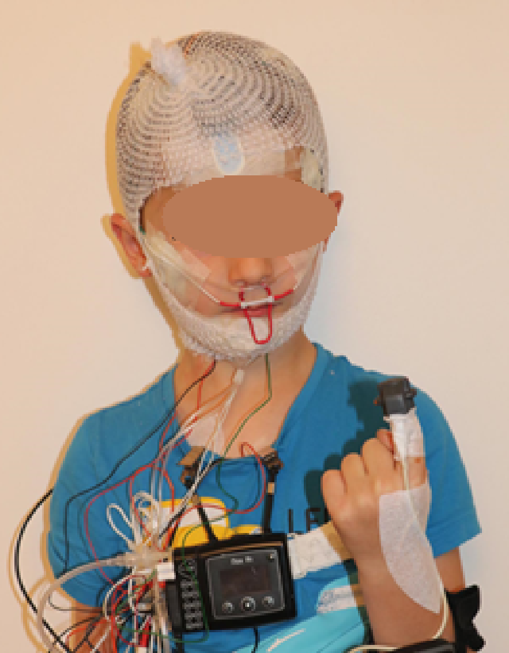
Home Polysomnography (H-PSG)
Data retrieved from H-PSG
Monitored EEG* (F4, F3, C4, C3, O2, O1 relied to contralateral mastoid electrodes)
2 EOG
Chin and legs EMG, ECG
Nasal airflow and thermistors
Respiratory inductance plethysmography (RIP) of chest and abdominal movement
SaO2
Audio
Position/movement
*The EEG electrodes were protected by a net around the head and a band over it

Slide 11
Home Polysomnography
Quality of H-PSG
The Noxturnal software rates signal quality and calculates the percentage of the study for which there was an adequate signal for the oximeter, airflow, abdominal and thoracic respiratory effort and generated an index of general quality of the study.
Arbitrarilly, a cut point superior to 75% was set to consider the quality of signal as satisfactory
When airflow was not available it was analyzed by the RIP flow, a calculated signal derived from the respiratory bands (AASM 2020).
Notes:
The Noxturnal software rates signal quality and calculates the percentage of the study for which there was an adequate signal for the oximeter, airflow, abdominal and thoracic respiratory effort and generated an index of general quality of the study.
Arbitrarilly, a cut point superior to 75% was set to consider the quality of signal as satisfactory.
When airflow was not available it was analyzed by the RIP flow, a calculated signal derived from the respiratory bands (AASM 2020).
The PSG was defined as interpretable when the signals were of good quality for more than 5 h.

Slide 12
DEFINITIONS
Definitions
OSAS was defined as:
Mild if AH Index > 1 and ≤ 5 events/h of sleep
Moderate if the AH Index > 5 and ≤ 10 events / h of sleep
Severe if AH Index > to 10 events/hour of sleep
PLMs disorder was identified if N° PLMs > to 5/hour of sleep.
Notes:
OSAS was defined as:
Mild if AH Index > 1 and ≤ 5 events per hour of sleep
Moderate if the AH Index was > 5 and ≤ 10 events per hour of sleep and
Severe if AH Index was > to 10 events per hour of sleep
Periodic limb movement PLMs disorder was identified if N° PLMs > to 5/hour of sleep.

Slide 13
VISUAL ANALOG SCALE on SATISFACTION
Visual analogical scale (VAS) on SATISFACTION
In the morning, parents and children completed VAS to rate
their satisfaction with home recording (0 to 10, with 10 being the best)
preference for performing PSG at home (0) or in hospital (10).
As a patient, did you enjoy this recording being made at home?
not at all |  |  |  |  |  |  |  |  | many
1 | 2 | 3 | 4 | 5 | 6 | 7 | 8 | 9 | 10
As a parent, did you enjoy this recording being made at home?
not at all |  |  |  |  |  |  |  |  | many
1 | 2 | 3 | 4 | 5 | 6 | 7 | 8 | 9 | 10
Would you have preferred that the recording be done in a hospital under supervision?
not at all |  |  |  |  |  |  |  |  | many
1 | 2 | 3 | 4 | 5 | 6 | 7 | 8 | 9 | 10

Slide 14
RESULTS

Slide 15
Flow Chart of the study
All patients/parents accepted to participate into the study
367 children
Underwent U-PSG (Jan-2018 to June-2021)
4 failled
To be reddone
363
Total population

Slide 16
Classical children population
363 consecutive children, aged 8.9 ± 3.3 years
15,5% under 6 y.o
61% between 6 and 11 y. o.
23,5% older than 12 y. o.
The main symptoms motivating the H-PSG study were:
Snoring (42%)
Nighttime awakenings (41%)
Daytime fatigue (40%)
Leg jerks at night (29%) associated or not to anormal sensations “I need to stretch my legs” or “legs bothering me all night” or “fighting with my squirmy legs” or “Bugs crawling in my legs”

Slide 17
Associated diseases
Associated disorders
43 patients had a prior diagnosis of ADD or ADHD,
32 patients with learning disabilities
12 patients with epilepsy

Slide 18
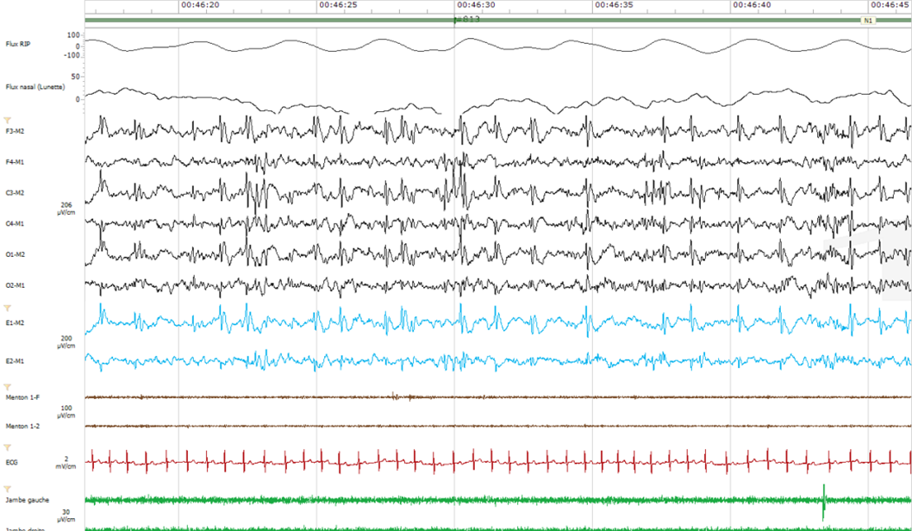
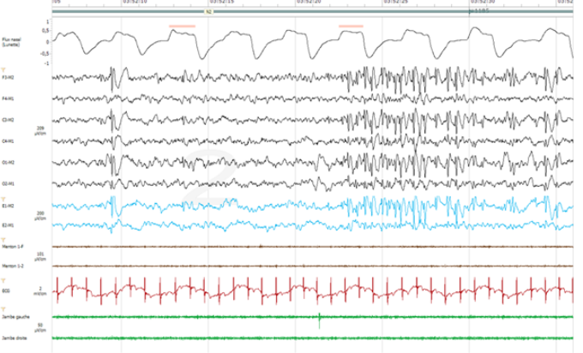
H-PSG can help detecting anormal EEG for follow-up of epilepsy or to derive a patient to a sleep laboratory?
Associated diseases
Repetitive spikes, every 1 -2 seconds in the left hemisphere (30 seconds page)
Repetitive slow spikes, in the left hemisphere in slow wave sleep (30 seconds page)

Slide 19
Visual analog scales results
Good satisfaction from parents and children with home PSG
As a patient, did you enjoy this recording being made at home?
not at all |  |  |  |  |  |  |  |  | many
1 | 2 | 3 | 4 | 5 | 6 | 7 | 8 | 8,9 ± 1,9 | 10
As a parent, did you enjoy this recording being made at home?
not at all |  |  |  |  |  |  |  |  | many
1 | 2 | 3 | 4 | 5 | 6 | 7 | 8 | 9,0 ± 1,7 | 10
Would you have preferred that the recording be done in a hospital under supervision?
not at all |  |  |  |  |  |  |  |  | many
1 | 2,1 ± 2,9 | 3 | 4 | 5 | 6 | 7 | 8 | 9 | 10

Slide 20
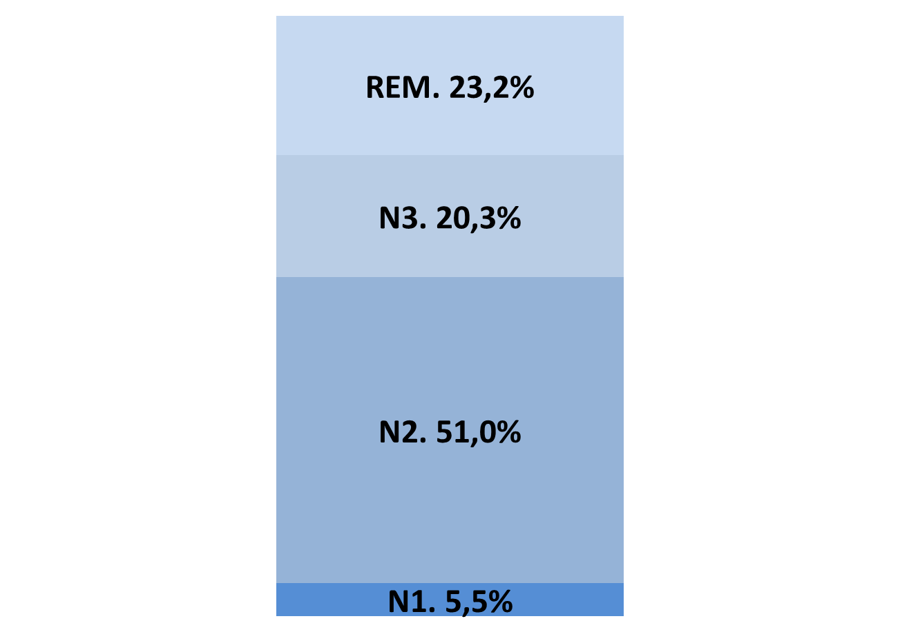
Results polysomnography
98% of patients had a diagnosis of a sleep disorder?
Sleep and Stages in % of TST
 | Mean ± SD (min - max)
Total sleep time (min.) | 549,5 ± 81,8 ( 998 – 338,5)
Micro-arousal index (/h) | 11,7 ± 5,1 ( 36,6 - 0)
Sleep efficiency (%) | 91,2 ± 6,6 (99 - 62)

Slide 21
98% of patients had a diagnosis of a sleep disorder
95,6% (347) obstructive sleep apnea (SAOS)
45,2 % with an AIH between 1 – 5/h
32,5 % with an AHI between 5 – 10/h
8,8 % with an AHI > to 10
34% (111 pts.) SAOS + PLMS
2,5% (9 pts.) isolated PLMs

Slide 22
Are ADD and/or ADHD associated with OSAS and/or PLMs? 1

Slide 23
Are ADD and/or ADHD associated with OSAS and/or PLMs?

Slide 24

Main limitation doesn’t seems to be a problem
The help and motivation of parents was crucial, as they had to wake up every 90 minutes to check the correct positioning of the nasal cannula and SaO2 sensors
Notes:
The help and motivation of parents was crucial for the realization of the U-PSG, as they had to wake up every 90 minutes to check the correct positioning of the nasal cannula and SaO2 sensor

Slide 25
CONCLUSION
This study shows the preference and satisfaction of parents and their children for H-PSG
Very good quality of signals allowing accurate diagnoses
It reinforces the interest of H-PSG at home among children
This cohort of 363 children is the largest described to our knowledge at present

Slide 26

Thank you very much
Notes:
Multi-channel polysomnography can be successfuly obtained in children

